Slide 1

Basic Details of the Team and Problem Statement
Organization Name: International Council For Circular Economy
PS Code: SG862
Problem Statement Title: Tracking Of Supply Chain To ReduceEnviromental
Team Name: WINGS
Team Leader Name: Kaushlendra Pratap Singh
Institute Code: RJ028
Institute Name: Poornima Institue of Engineering & technology
Theme Name:

Slide 2
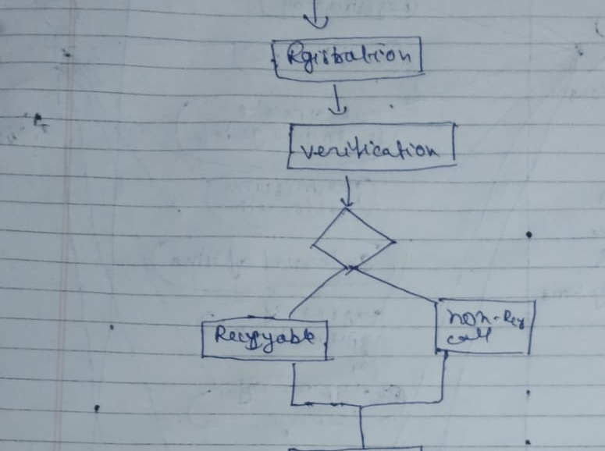
Idea/Approach Details
Describe your idea/Solution/Prototype here:
We are building an app where we register all the resturants,colony,cities,Shops,etc. But or main focus are resturants and shops. We collect garbags in all forms like plastics and biodigrable waste. We collect biodegrable waste gave to farm as well as we can prepare bio gas. Like that we collect plaste and gave to nagar nigam where they can use it for making roads and also we can gave plastics to industries where they can recycle it.like wise the glass can also gave to industries to reuse it.
So if the restruants and colony gave their waste to use they also get some profit like for resturants we make 3 types of list Green,Yellow,Red.Where the most benefit list is Green list where we are helping the resturants for getting more and more customers
As per most preferred to least preferred we use these process - prevention,reuse ,recycling ,recovery ,disposal .
Describe your Technology stack here:
Firstly we register all (restaurants, shops ,etc)
Collection of waste from all
Differentiate the waste in three parts as per the collection
We give the points to restaurants according to their waste
On the basis of the performance we make list as red ,yellow and green.

Slide 3
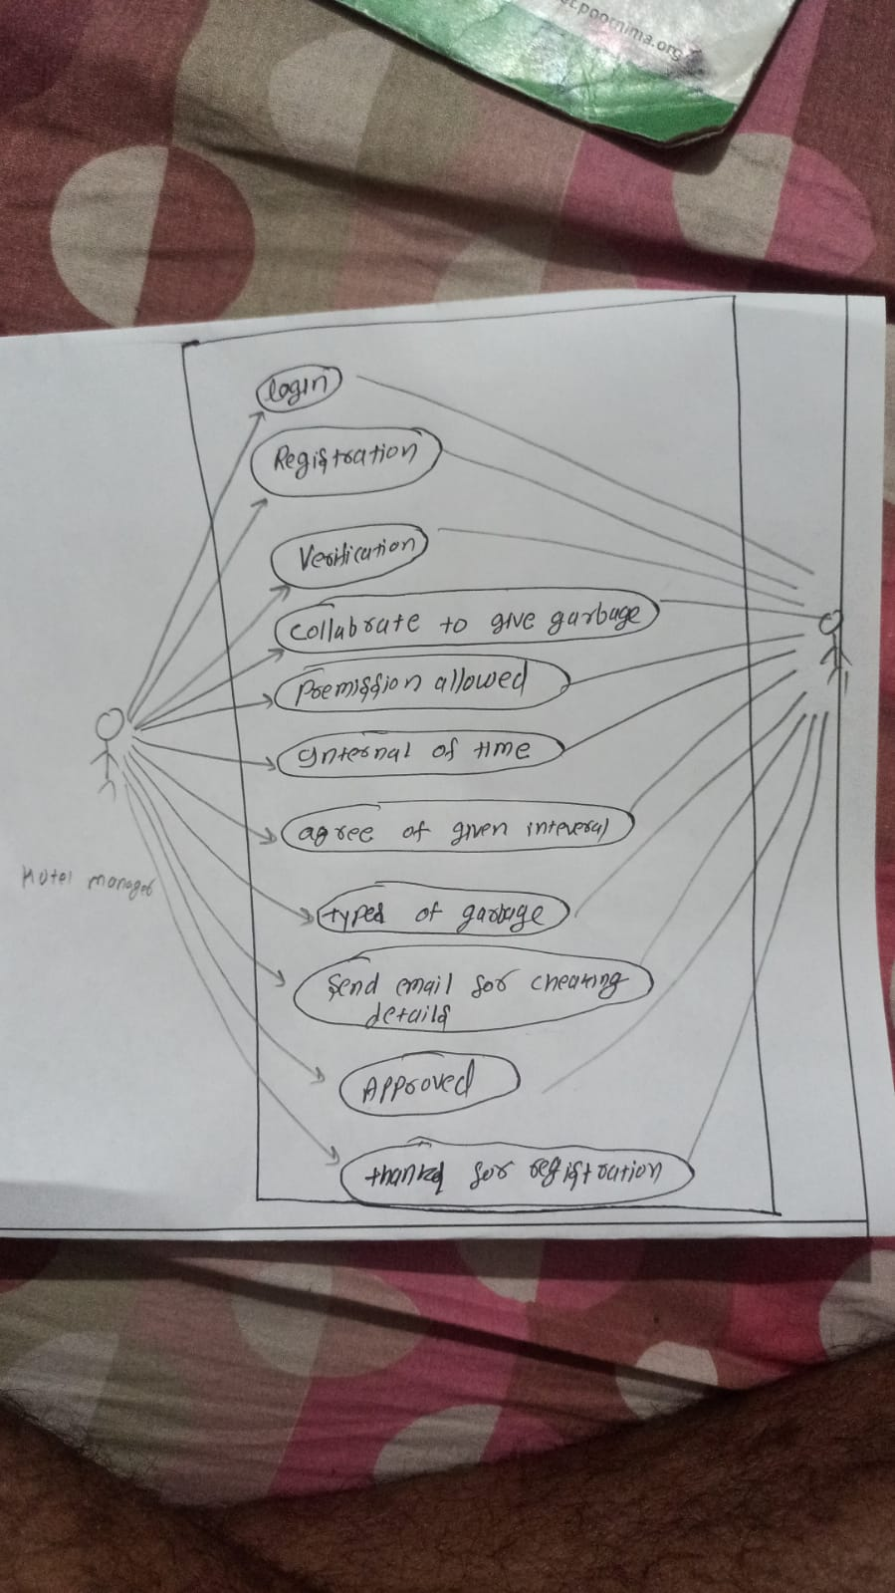
Idea/Approach Details
Describe your Use Cases here
Describe your Dependencies / Show stopper here

Slide 4
Team Member Details
Team Leader Name: Kaushlendra Pratap Singh
Branch (Btech): Stream (CSE ): Year (II):
Team Member 1 Name: Kumari Khushboo
Branch (Btech): Stream (CSE ): Year (II):
Team Member 2 Name: Kanchan
Branch (Btech): Stream (CSE ): Year (II):
Team Member 3 Name: Jayendra Sharma
Branch (Btech): Stream (CSE ): Year (II):
Team Member 4 Name: Jayant Kumar
Branch (Btech): Stream (CSE ): Year (II):
Team Member 5 Name: Ishu Kumar
Branch (Btech): Stream (CSE ): Year (II):

